Slide 1


UPDATE ON SCHISTOSOMIASIS SUB-DISTRICT* LEVEL DATA REVIEW FOR TARGETED TREATMENTS
Better utilization of available Schistosomiasis site level data to plan MDA targeted at sub-district* levels
*Lowest possible administrative level for which demographic data is available

Slide 2
UPDATE ON SCHISTOSOMIASIS SUB-DISTRICT* LEVEL DATA REVIEW FOR TARGETED TREATMENTS
  Webinar Objectives:
    To update schistosomiasis control and elimination stakeholders in the Africa Region on progress made on schistosomiasis sub-district data analysis for targeted treatments
    Share timelines on JAP for 2021, and the expectations for 2021 medicines applications for schistosomiasis

Slide 3
Agenda
Time | Activity/Topic | Facilitator / Speaker
5 Minutes 10 Minutes | Introduction Opening remarks and global update | Dr Maria Rebollo Dr Amadou Garba
20 Mins | Concept and progress update | Dr Pauline Mwinzi
15Mins | Question and Answer | ALL
40 Minutes | Overview of SCH-Sub district analysis workbook | Mr Boniface Kinvi
20 Minutes | Country experience | Uganda
5 minutes 5 mimutes | Remarks on JAP timelines SCM issues | Honorat Zoure Modeste Tezembong
20 Minutes | Q&A | ALL
5 Minutes | Closing remarks | ESPEN

Slide 4
Schistosomiasis
Global updates

Slide 5
NTDs in the context of the Covid 19

Slide 6
WHO interim guidance
WHO interim guidance released on 1st of April
  Community-based surveys, active case-finding activities and mass treatment campaigns for NTDs should be postponed until further notice
  Diagnosis, treatment and care of NTDs for patients presenting to healthcare facilities, and essential vector control measures, should continue, as these are critical interventions
  Existing NTD platforms, surveillance mechanisms and WASH/health education opportunities can be used to support implementation of COVID-19-related measures

Slide 7
Joint WHO-IFRC-UNICEF document for community-based and outreach interventions
Generic recommendations on community-based and outreach interventions during COVID-19
Specific considerations for different areas:
  HIV, TB, mental health, NCDs, vaccination, NTDs, malaria
Other considerations:
  Maternal and newborn health, children and adolescents, older people, etc.
5 May 2020

Slide 8
Guidance on NTD community-based interventions in the context of COVID-19
Community-based surveys, mass treatment and active case-finding
  Activities should be temporarily suspended
  Countries should monitor and re-evaluate at regular intervals the necessity for delaying these activities
  Risk-benefit assessment on an event-by-event basis can be considered in areas with:
    increased incidence or significant burden of disease
    provided safe and high-quality health interventions can be conducted in the context of the COVID-19 pandemic

Slide 9
Guidance on NTD community-based interventions in the context of COVID-19
Vector control and veterinary public health
  In areas with no community transmission of COVID-19, activities should continue with precautions (physical distancing, hand hygiene, respiratory etiquette)
  In areas with community transmission of COVID-19, only essential activities should continue:
    Source reduction of vector breeding sites in and around houses
    Mass animal vaccination campaigns and euthanasia or rabid animals
Community-based WASH
  Activities should continue
Individual case-management
    Dealt with in a separate guidance on essential health services

Slide 10
Maintaining essential health services. Operational guidance for the Covid 19 context
a) Support continuity of treatment and follow-up:
  Dispensing medicines for treatment of Buruli ulcer, leprosy, mycetoma, chromoblastomycosis and deep mycoses for longer periods allowing reduced frequency of patient visits, e.g.,
  • Diagnostics tests and access to care for Dengue patients prevent unnecessary mortality.
Proactive planning, procurement and supply management.
Revise national implementation plans under more than a single scenario- Tentative new dates, mobilize resources, medicine inventory and prevent expiry
d) Maintaining systems and database for monitoring and evaluation of patients, including a register of patients including lab registers, treatment outcome monitoring cards etc.

Slide 11
Considerations on implementation of mass treatment interventions for neglected tropical diseases in the context of the COVID-19 pandemic- New guidance
“Upon detection in a given geographical area of (a) a sudden increase in the incidence of NTD infections or (b) a significant burden of disease, the decision to resume or commence active case finding or mass treatment campaigns, or both, will require a risk-benefit assessment on an event-by-event basis; the assessment must factor in the health system’s capacity to effectively conduct safe and high-quality health interventions in the context of the COVID-19 pandemic”.
The risk-benefit assessment process that should guide the decision as to whether a mass treatment intervention or active case-finding campaign should resume or commence, assuming conditions (a) or (b) above are met;
Mitigation measures that should be applied to decrease risk of transmission of SARS-CoV-2 in conjunction with the mass treatment intervention or active case-finding campaign

Slide 12
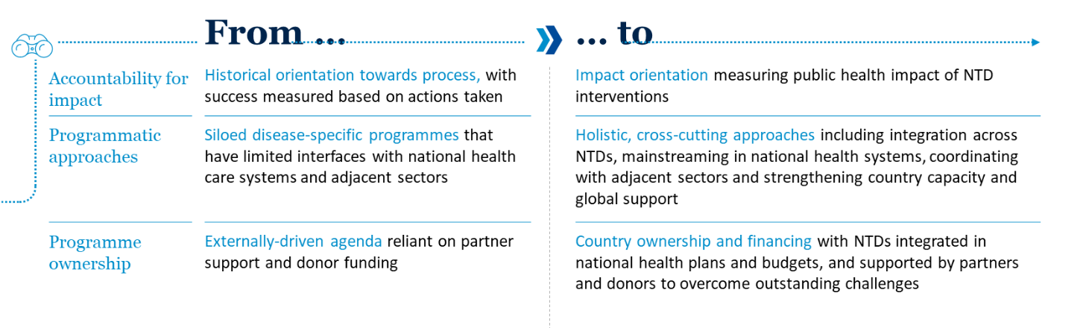
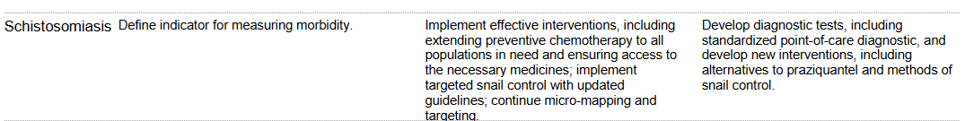
NTD road map 2021-2030: Shifting in approaches to addressing NTDs

Slide 13
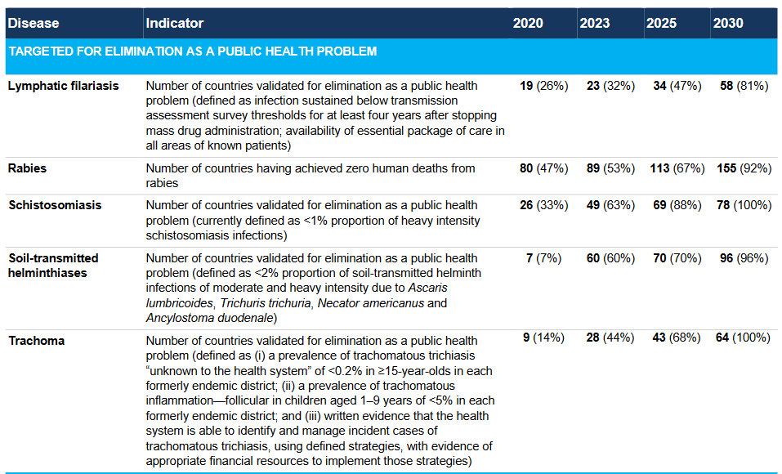
Proposed road map targets, milestones and indicators

Slide 14
Summary of suggested new protocols for mapping and impact assessment
 | UC2 Protocol 1 (to be used when prevalence is ≥x%) | UC2 Protocol 2-1 (to be used when prevalence is <x%) | UC2 Protocol 2-2 (LQAS, to be used when prevalence is <x%)
Diagnostics | Sm: Kato Katz, 1 stool sample, 2 slides Sh: UF, 10 ml/1 filter (prevalence and intensity of infection) | RDT, rapid diagnostic tests:CCA, Hemastix, questionnaire etc. (For estimate prevalence) | RDT, rapid diagnostic tests CCA, Hemastix, questionnaire etc.
Samples | Three age groups: PSAC (2-5 years) SAC (6-14 years) Adults (≥15 years) 20 persons per age group, randomly selected, tbc by modelling Location: community-based survey | SAC (6-14 years) 15-30 SAC per school, randomly selected Location: school-based survey | SAC (6-14 years) Number and thresholds to be defined Location: school-based survey
Frequency of survey | Once every 5-6 years | Once every 5-6 years | Once every 5-6 years
Survey Unit | Sub-district: one or more Health Catchment Area – can be combined according to epidemiological and ecological situation | Sub-district: one or more Health Catchment Area – can be combined according to epidemiological and ecological situation | Sub-district: one or more Health Catchment Area – can be combined according to epidemiological and ecological situation
No of survey sites | Up to 5, per sub-district | All schools in sub-district | All schools in sub-district
Exclusion criteria | Non-endemic areas, defined from all available information (survey, clinical, epidemiological, ecological etc.) | Non-endemic areas, defined from all available information (survey, clinical, epidemiological, ecological etc.) | Non-endemic areas, defined from all available information (survey, clinical, epidemiological, ecological etc.)
Site selection | Purposeful selection | All schools | All schools

Slide 15
New schistosomiasis guideline
To provide evidence based recommendations to countries in their effort to accomplish morbidity control and to move to the eventual interruption of transmission
  Integrated strategy- PC, snail control, environment management, Wash, one health
  Treatment of all at risk groups
  Simplified MDA - No treatment holiday, New threshold for implementing MDA
  Verification of interruption of transmission- Diagnostic tools for Schistosoma infection in snails, animals and human

Slide 16
Agenda
Time | Activity/Topic | Facilitator / Speaker
5 Minutes 10 Minutes | Introduction Opening remarks and global update | Dr Maria Rebollo Dr Amadou Garba
20 Mins | Concept and progress update | Dr Pauline Mwinzi
15Mins | Q&A | ALL
40 Minutes | Overview of SCH-Sub district analysis workbook | Mr Boniface Kinvi
20 Minutes | Country experience | Uganda
5 minutes 5 mimutes | Remarks on JAP timelines SCM issues | Honorat Zoure Modeste Tezembong
20 Minutes | Q&A | ALL
5 Minutes | Closing remarks | ESPEN

Slide 17
UPDATE ON SCHISTOSOMIASIS SUB-DISTRICT* LEVEL DATA REVIEW FOR TARGETED TREATMENTS
Better utilization of available Schistosomiasis site level data to plan MDA targeted at sub-district* levels
*Lowest possible administrative level for which demographic data is available

Slide 18
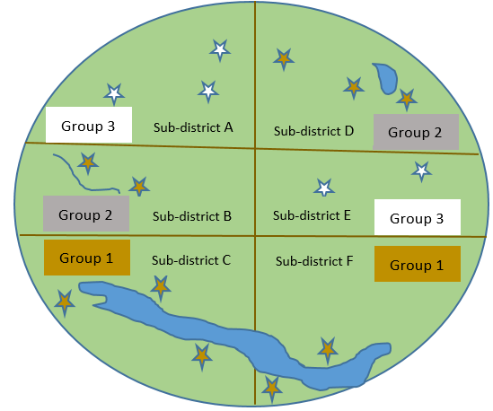
A significant amount of the regional SCH endemicity data comes from the AFRO NTD mapping project 2012-2015
For each mapping unit, one prevalence will be estimated and all
sub-districts in the group classified as non-endemic, low, moderate or high-risk area. One treatment strategy will be decided based on this classification.

Slide 19
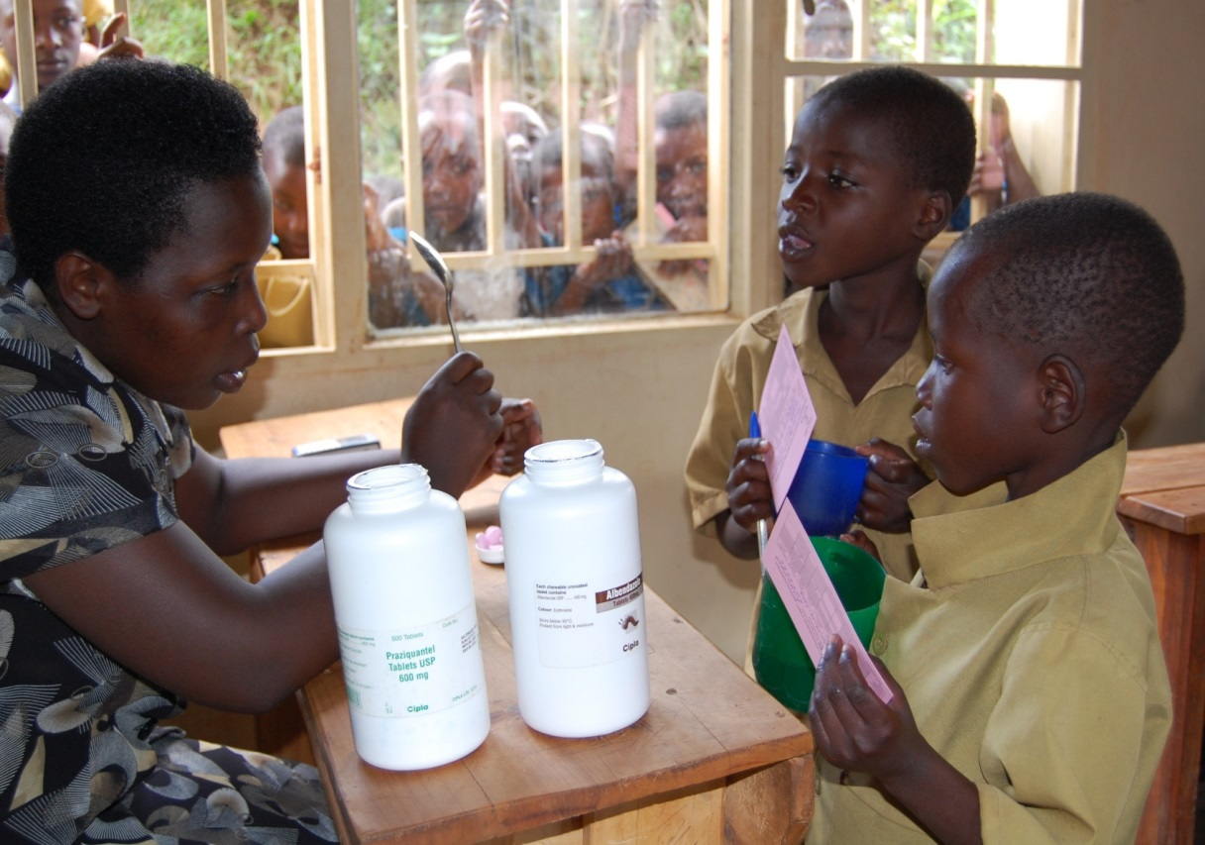
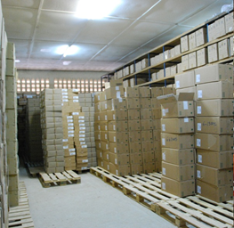

PC implementation at district level
In many countries PC is based on district level overall prevalence
Implementation at district level leads to over-treatment of non exposed communities and/or under-treatment of exposed communities

Slide 20
Preliminary analysis has shown possibility of shrinking the map and adjusting PZQ tablets
Delineating prevalence data to sub-district levels will expose further mapping gaps, and help focus SCH treatment
Busia District, Kenya | Overall prevalence = 24.1%
Sub-District | Number of Schools/sites | Examined | Positive | Prevalence (%)
Amagoro | 2 | 120 | 0 | 0
Amukura | 1 | 60 | 1 | 1.7
Angurai | 1 | 59 | 5 | 8.5
Budalangi | 4 | 232 | 118 | 50.9
Chakol | 4 | 56 | 3 | 5.4
Funyula | 3 | 179 | 43 | 24.0
Overall | 12 | 706 | 170 | 24.1

Slide 21
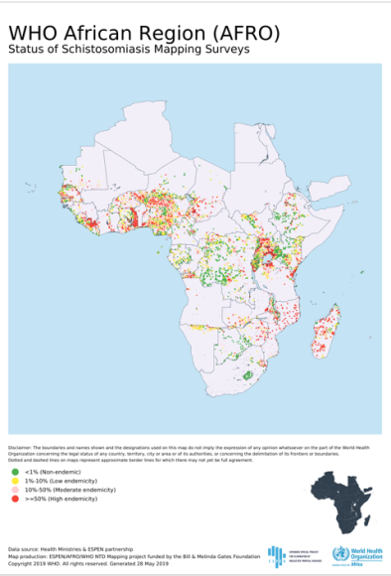
Updated Regional schistosomiasis data
SCH mapping surveys completed in 41 countries by 2015 including NTD/AFRO Mapping Project in 22 countries
Further data was consolidated from other databases e.g GAHI
Since 2018; teams of trained data experts were deployed to countries to support data compilation of data sets available in countries. Partners have also shared data

Slide 22
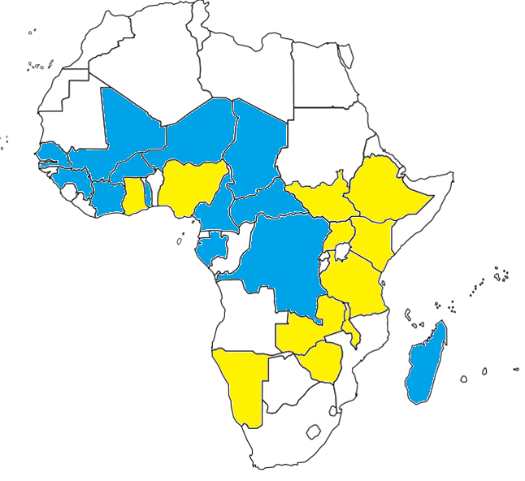

Countries trained so far
Burkina Faso
Côte d'Ivoire
Cameroon
CAR
Chad
DRC
Gabon
Guinea
Madagascar
Mali
Niger
Senegal
Togo
Ethiopia
Ghana
Kenya
Malawi
Namibia
Nigeria
South Sudan
Tanzania (Mainland)
Uganda
Zambia
Zimbabwe
  Outputs:
  Sub-district (lowest administrative level possible) analysis using available site level data
  Sub-District level MDA planning
  Revise PZQ needs based on map shrinking using available data
  Present mapping data gaps

Slide 23
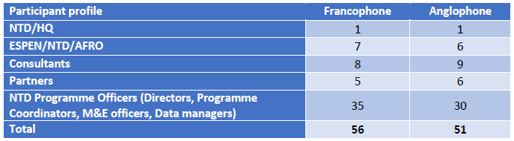

Country selection criteria for initial training
Population requiring PC higher than 2.5 M persons and where impact in shrinking the map can be significant.
Availability of sub-district level data, or possibility to obtain the same in good time.
Preliminary analysis showing that further sub-district level analysis and planning can shrink the country map using currently available data.
* Countries that have recently finalized their SCH mapping were also invited

Slide 24
Data quality
Use reported endemicity in (JRSM)
NO
Data available at IU level
YES
Data quality category
Data was collected before 2000. OR after 2000 but with poor (>1)/no reporting on diagnostic and prevalence
Data was collected 2000-2004, appropriate diagnostic(1), number examined is reported and sample is adequate
Data was collected after 2004, appropriate diagnostic (1), number examined is reported and sample is adequate
(3)
(2)
(1)

Slide 25
Decision tree
IU Data quality
(1 ) (2) (3)
Sub-IU prevalence
Negative
Unknown
Positive
Environmental suitability/
local knowledge on dis epi
NO
Endemicity categories
Low: <10%
Moderate:10-49%
High: =/>50%
YES
Similar to a neighbouring
sub-IU
Not similar to any neighbouring sub-IU
No PC needed
Apply treatment decision of that neighbouring sub-IU
Apply treatment decision of parent IU
Use sub-IU data to assign endemicity category and decide next steps of treatment

Slide 26
GIS maps
produced by ESPEN
Water bodies and wetlands, population density and site-level data

Slide 27
Atlas of the global distribution of schistosomiasis 1987
WHO

Slide 29
Sub-district level final decision on implementation
Use-sub IU endemicity
Use IU endemicity
Use JRSM endemicity
Use adjacent highest endemicity
Need further assessment*
Non-endemic
Admin_3 (sub-IU, sub-district) | Endemicity category calculated by the IU data | Endemicity category reported by the latest JRSM | Endemicity category calculated by the sub-IU data | Final Decision | Final Endemicity Category
Ewalel | Not endemic | Not endemic | Unknown | 6. Not endemic | Not endemic
Kabarnet | Not endemic | Not endemic | Not endemic | 1. Use sub-IU endemicity | Not endemic
Kapropita | Not endemic | Not endemic | Not endemic | 1. Use sub-IU endemicity | Not endemic
Sacho | Not endemic | Not endemic | Unknown | 2. Use IU endemicity | Not endemic
Tenges | Not endemic | Not endemic | Not endemic | 1. Use sub-IU endemicity | Not endemic
Bartabwa | Low | Not endemic | Unknown | 2. Use IU endemicity | Low
Barwessa | Low | Not endemic | Low | 1. Use sub-IU endemicity | Low
Kabartonjo | Low | Not endemic | Low | 1. Use sub-IU endemicity | Low
Saimo | Low | Not endemic | Unknown | 2. Use IU endemicity | Low
Saimo | Low | Not endemic | Unknown | 2. Use IU endemicity | Low
Ilchamus | Not endemic | Not endemic | Not endemic | 1. Use sub-IU endemicity | Not endemic
Marigat | Not endemic | Not endemic | Not endemic | 1. Use sub-IU endemicity | Not endemic
Mochongoi | Not endemic | Not endemic | Not endemic | 1. Use sub-IU endemicity | Not endemic
Mukutani | Not endemic | Not endemic | Not endemic | 1. Use sub-IU endemicity | Not endemic
Koibatek | Low | Not endemic | Unknown | 2. Use IU endemicity | Low

Slide 30
Comparison between district level and sub district level endemicity categories
District | Number of sub-districts | Endemicity by District Prevalence |  |  |  | Endemicity by Sub district Prevalence
 |  | Non endemic | Low | Moderate | Unknown | Non endemic | Low | Moderate | High | Unknown
Bafata | 14 |  | 14 |  |  |  | 5 | 2 |  | 7
Bijagós | 11 |  |  |  | 11 |  |  |  |  | 11
Biombo | 8 | 8 |  |  |  | 3 |  |  |  | 5
Bolama | 3 | 3 |  |  |  | 2 |  |  |  | 1
Cacheu | 19 |  | 19 |  |  | 6 | 1 |  |  | 12
Farim | 5 |  |  | 5 |  |  | 1 |  | 1 | 3
Gabú | 19 |  | 19 |  |  | 1 | 4 | 1 |  | 13
Oio | 10 | 10 |  |  |  | 4 |  |  |  | 6
Quinará | 6 | 6 |  |  |  | 4 |  |  |  | 2
SAB | 14 |  | 14 |  |  | 2 | 2 |  |  | 10
Tombali | 8 |  | 8 |  |  | 3 | 2 |  |  | 3
Total | 117 | 27 | 74 | 5 | 11 | 25 | 15 | 3 | 1 | 73
Example of Bafata: the 14 sub-districts are classified low risk under the district prevalence. But when using the sub-district prevalence, only 5 are actually low risk, 2 moderate and 7 do not have data

Slide 31
SCH: Technical support to 22 countries for sub-district planning, and adjusted PZQ needs estimation
# of sub-IU | SAC estimates (IU endemicity) | SAC estimates (sub-IU endemicity) | PZQ estimates for SAC (IU endemicity) | PZQ estimates for SAC (sub-IU endemicity) | Variation in SAC and PZQ estimates
6,012 | 12,172,422 | 11,346,275 | 30,432,077 | 28,366,454 | -6.79%
There is globally a decrease of 6.79% on treatment needs (population and medicines)
This concerns only 6012 (14.4%) sub-IUs out of 41817
Underestimates and Overestimates of PZQ
# of sub-IUs | SAC adequately treated | SAC missing treatment | SAC unnecessarily treated | Unclaimed PZQ | Misused PZQ
6,012 | 7,606,279 | 1,372,329 | 2,198,476 | 3,431,055 | 5,496,542

Slide 32
Adequate and Inadequate Treatment Strategy in # IUs
Adequate treatment | Over Treatment | Under Treatment | Inadequate strategy
3,672 | 1,558 | 782 | 2,340
61.1% | 25.9% | 13.0% | 38.9%
Overall, there is 40% inadequacy against 60% adequacy

Slide 33
Sub-district level implementation analysis for Schistosomiasis for all 44 countries
Country Workbooks updated:
  Workbooks are updated in the new version of the Tool for 23 countries (13 francophone and 10 anglophone) that attended 2019 workshops
  Workbooks are created/reviewed/updated in the new version of the tool for 11 countries (5 francophone and 6 anglophone) that are planned for 2020 workshops
    These countries are Angola, Benin, Botswana, Burundi, Congo, Gambia, Guinea Bissau, Liberia, Mozambique, Sierra Leone, South Africa

Slide 34
Sub-district level implementation analysis for Schistosomiasis for all 44 countries
Collaborations with countries
  Communications (email, call) are carried out with all countries for ongoing support, and webinars have been held with the following countries:
Country | Date
Guinea | 20-apr.-2020
Mozambique | 7-may-2020
Angola | 13-may-2020
Benin | 21-may-2020
Sierra Leone | 27-may-2020
Malawi | 22-jun.-2020
Guinea-Bissau | 23-jun.-2020
Liberia | 3-jul.-2020

Slide 35
Summary of PZQ needs based on the sub-district analysis for all 44 countries
  Population needing PC are estimated for 35* countries (see list below)
    by age (SAC and adults),
    for three years (2020-2022).
*Angola, Benin, Botswana, Burkina Faso, Burundi, Cameroun, Chad, Congo, Côte d'Ivoire, Gabon, Gambia, Ghana, Guinea Bissau, Guinée, Kenya, Liberia, Madagascar, Malawi, Mali, Mauritania, Namibia, Niger, Nigeria, RCA, RDC, Sénégal, Sierra Leone, South Africa, South Sudan, Tanzania (Mainland & Zanzibar), Togo, Uganda, Zambia, Zimbabwe.

Slide 36
JRSM outputs based on the sub-district level analysis
  Data sets to be included in JRSM are generated conformally to JRSM format
  Itemized sub-IU data sets are also generated
  2021 JRSM are being pre-populated with JRSM outputs before sending to countries
    This is done for 25 countries (see list below)*
  And where still possible, JRSM outputs are used to review 2020 PZQ requests
* Benin, Burkina Faso, Burundi, Cameroun, Chad, Côte d'Ivoire, Gabon, Gambia, Guinea Bissau, Guinée, Kenya, Madagascar, Malawi, Mali, Namibia, Niger, RCA, Sénégal, Sierra Leone, South Sudan, Tanzania (Mainland), Togo, Uganda, Zambia, Zimbabwe

Slide 37
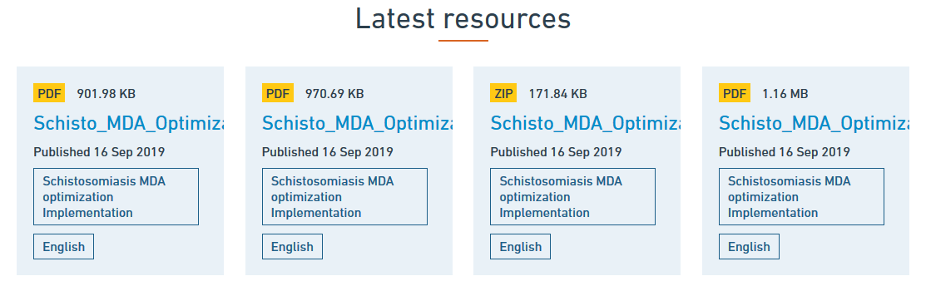
http:// espen.afro.who.int

Slide 38
Agenda
Time | Activity/Topic | Facilitator / Speaker
5 Minutes 10 Minutes | Introduction Opening remarks and global update | Dr Maria Rebollo Dr Amadou Garba
20 Mins | Concept and progress update | Dr Pauline Mwinzi
15Mins | Q&A | ALL
40 Minutes | Overview of SCH-Sub district analysis workbook | Mr Boniface Kinvi
20 Minutes | Country experience | Uganda
5 minutes 5 mimutes | Remarks on JAP timelines SCM issues | Honorat Zoure Modeste Tezembong
20 Minutes | Q&A | ALL
5 Minutes | Closing remarks | ESPEN

Slide 39
Agenda
Time | Activity/Topic | Facilitator / Speaker
5 Minutes 10 Minutes | Introduction Opening remarks and global update | Dr Maria Rebollo Dr Amadou Garba
20 Mins | Concept and progress update | Dr Pauline Mwinzi
15Mins | Question and Answer | ALL
40 Minutes | Overview of SCH-Sub district analysis workbook | Mr Boniface Kinvi
20 Minutes | Country experience | Uganda
5 minutes 5 mimutes | Remarks on JAP timelines SCM issues | Honorat Zoure Modeste Tezembong
20 Minutes | Q&A | ALL
5 Minutes | Closing remarks | ESPEN

Slide 40
Schistosomiasis sub-district level* data Analysis for shrinking the map, targeted treatments, better utilization of available prevalence data and sub-district level planning
Data Analysis Methodology
*Lowest possible administrative level for which demographic data is available

Slide 41
Data Needs
Four categories of datasets are needed:
  Epidemiological data
  Demographic data
  Spatial (GIS) data
  Last PZQ Request data
  Notes:
  The subdivision level of the epidemiological, demographic, and spatial data should be the sub-district

Slide 42
Input Data -Epidemiological Data
Site prevalence data with following characteristics
  on the site/location
    Admin 1, usually Region/Province/State
    Admin 2, usually district, county (IU)
    Admin 3 or lower, usually sub-district, sub-county, ward
    Surveyed site (HF, school, community, etc.)
    GPS coordinates (latitude, longitude)
  On the disease
    Number of people tested
    Number of positive tests
    Prevalence rate (%)
    Methods of diagnostic
    Type of schistosomiasis
    Species tested
    Type of survey (initial mapping, impact, etc.)
  On the time
    Year of survey
    Notes
    Admin 1 and Admin2 can be the same in some countries (usually small country)
    Admin 3 is the level considered as the sub-IU level for which the sub-district analysis will be conducted (can be any sub-level below the IU level for which demographic data are available)

Slide 43
Input Data - Demographic Data
Demographic Data of sub-district with following data items
  Admin 1, usually Region/Province/State
  Admin 2, usually district, county (IU)
  Admin 3 or lower, usually sub-district, sub-county, ward
  Total population of the sub-district
  Year of population
  Percentage of school age children
  Percentage of adults
  Population Growth Rate (by sub-district, or district, province or national)
  Notes: Population percentage and population growth rate give better estimates if they are by sub-district

Slide 44
Input Data – Spatial Data
Spatial data if available may include:
  Shapefile of:
    Sub-district boundaries
    Sub-district spatial relationships
      List of neighboring sub-district of each sub-district
      Length of shared borders between sub-district and its neighbors
    Population density
    Hydrography (water bodies, wetlands, etc.)
    Forests, Game parks and reserves

Slide 45
Input Data – Current Drugs Request Data
  Latest data reported in PZQ request form may include:
    Endemicity category of the IUs
    Population of the IUs
    Treatment Plan of the IUs
      Last treatment plan
      Treatment history for at least the last 3 years

Slide 46
Output Data – Endemicity Calculations
Prevalence calculation of IUs and sub-IUs
    Prevalence calculated from the site data
      For available diagnostic methods
      For available years
Determination of endemicity category of IUs and sub-IUs
    Endemicity category is determined
      From the prevalence values
      Only Prevalence values that comply with WHO recommendations are considered
      Other prevalence values will serve as indication of the presence or not of the disease
Main
Content
Notes: Endemicity category is determined using the WHO Guidelines

Slide 47
WHO Guidelines on Schistosomiasis Risk Classification
Category | Baseline prevalence among school-age children | Action to be taken |  | Additional interventions
High-risk community | >=50% by parasitological methods (intestinal and urogenital schistosomiasis) or >= 30% if based on questionnaires for history of haematuria or >= 60% by CCA in S. mansoni endemic areas | Treat all school-age children (enrolled and not enrolled) once a year | Also treat adults considered to be at risk (from special groups to entire communities living in endemic areas) | Water, sanitation Improve, hygiene education (WASH) snail control
Moderate-risk community | >=10% but <50% by parasitological methods (intestinal and urogenital schistosomiasis) Or <30% by questionnaire for history of haematuria Or >=15%but <60% by CCA in S. mansoni endemic areas | Treat all school-age children (enrolled and not enrolled) once every 2 years (essentially treat 50% of this age group each year) | Also treat adults considered to be at risk | Water, sanitation and hygiene education (WASH) snail control
Low-risk community | <10% by parasitological methods (intestinal and urogenital schistosomiasis) Or <15% by CCA in S. mansoni endemic areas | Treat all school-age children (enrolled and not enrolled) twice during their primary schooling age (treat at least 33% of this age group each year) | Praziquantel should be available in dispensaries and clinics for treatment of symptomatic cases | Water, sanitation and hygiene education (WASH) snail control
Main
Content

Slide 48
Output Data –Endemicity Categories
Classification of endemicity category of IUs and sub-IUs
    Endemicity category are classified as:
      Non endemic
      Low endemicity
      Moderate endemicity
      High endemicity
      Unknown endemicity
Main
Content

Slide 49
Output – Sub-IU Final Endemicity
Final endemicity of the sub-IU is determined using the Final Decision Tree
The value may be one of the followings:
  Endemicity category obtained for the IU
  Endemicity category obtained for the sub-IU
  Endemicity category obtained from a neighbouring sub-IU
  Endemicity category reported for the last PZQ Request
Main
Content

Slide 50
Output – Sub-IU Final Endemicity
SN | District | Sub-district | Endemicity category calculated by the IU data | Endemicity category reported by the latest JRSM | Endemicity category calculated by the sub-IU data | Final Decision | Final Endemicity Category
171 | District 01 | Sub-district 01 | Moderate | Moderate | Unknown | 2. Use IU endemicity | Moderate
1 | District 01 | Sub-district 02 | Moderate | Moderate | Moderate | 1. Use sub-IU endemicity | Moderate
2 | District 01 | Sub-district 03 | Moderate | Moderate | Unknown | 4. Use highest adjacent endemicity | High
3 | District 01 | Sub-district 04 | Moderate | Moderate | Unknown | 4. Use highest adjacent endemicity | Moderate
4 | District 01 | Sub-district 05 | Moderate | Moderate | Unknown | 4. Use highest adjacent endemicity | High
5 | District 01 | Sub-district 06 | Moderate | Moderate | High | 1. Use sub-IU endemicity | High
6 | District 01 | Sub-district 07 | Moderate | Moderate | Unknown | 4. Use highest adjacent endemicity | Moderate
7 | District 01 | Sub-district 08 | Moderate | Moderate | Unknown | 4. Use highest adjacent endemicity | High
8 | District 01 | Sub-district 09 | Moderate | Moderate | Moderate | 1. Use sub-IU endemicity | Moderate
9 | District 01 | Sub-district 10 | Moderate | Moderate | Moderate | 1. Use sub-IU endemicity | Moderate
10 | District 01 | Sub-district 11 | Moderate | Moderate | Moderate | 1. Use sub-IU endemicity | Moderate
11 | District 01 | Sub-district 12 | Moderate | Moderate | Low | 1. Use sub-IU endemicity | Low
12 | District 01 | Sub-district 13 | Moderate | Moderate | Unknown | 4. Use highest adjacent endemicity | High
13 | District 01 | Sub-district 14 | Moderate | Moderate | Moderate | 1. Use sub-IU endemicity | Moderate
14 | District 01 | Sub-district 15 | Moderate | Moderate | High | 1. Use sub-IU endemicity | High
Main
Content

Slide 51
Output Data – Calculations of Population Requiring PC
Estimation of populations and medicines
    According to endemicity category
      Estimation of SAC
      Estimation of adults
      Estimation of PZQ for SAC
      Estimation of PZQ for adults
Main
Content

Slide 52
Output Data - Gains of the sub-district level
Gains of the sub-district level implementation
  Treatment strategy adequacy
    Adequate treatment
    Under treatment
    Over treatment
Main
Content

Slide 53
Output Data - Gains of sub-district level
Changes in Endemicity categories
Endemicity category calculated (UI) |  | Endemicity category calculated (sub-IU)
 |  | Not endemic | Low | Moderate | High
Not endemic | 5 | 4 | 1 | 0 | 0
Low | 20 | 5 | 3 | 12 | 0
Moderate | 28 | 4 | 6 | 5 | 13
High | 53 | 8 | 0 | 6 | 39
Total sub-units | 106 | 21 | 10 | 23 | 52
Treatment adequacy in district level implementation
 | Adequate Treatment | Under Treatment | Over Treatment | Total
South | 7 | 6 | 8 | 21
West | 15 | 1 | 3 | 19
North | 12 | 9 | 10 | 31
East | 17 | 10 | 8 | 35
Total | 51 | 26 | 29 | 106
20 low risk changed to 5 non endemic, 3 low, 12 moderate
A total of 55 sub-units are inadequately treated against 51 that are adequately treated
Treatments inequity in district level implementation
 | Total | SAC adequately treated | SAC missing treatment | SAC over treated | Gaps in drugs | Drugs Over used
South | 21 | 22,291 | 6,803 | 31,991 | 17,009 | 79,980
West | 19 | 35,992 | 2,611 | 10,921 | 6,528 | 27,303
North | 31 | 33,566 | 20,831 | 57,218 | 52,080 | 143,047
East | 35 | 87,144 | 8,392 | 23,592 | 20,982 | 58,981
Total | 106 | 178,993 | 38,637 | 123,722 | 96,599 | 309,311
Globally, the number of overestimated tablets of PZQ is more than the gaps in underestimated areas

Slide 54
Output Data – Medicines Request
Geography |  |  |  |  |  | EPI | Annual Treatment Projections - 2020
SN | Country | ISO2 | Province | District | ESPEN_IU_ID | Endemicity | SAC Requiring PC | Adult Requiring PC | Total Requiring PC | Planned for Rx | # of sub-units to treat | SAC Estimations for Rx | Adult Estimations for Rx | Total Estimations for Rx
1 | Murkonia | MRK | South | Astori | 1 | 2 | 28,039 | 18,225 | 46,264 | 0 | 0 | 0 | 0 | 0
2 | Murkonia | MRK | South | Brodsi | 2 | 2 | 6,880 | 4,473 | 11,353 | 0 | 0 | 0 | 0 | 0
3 | Murkonia | MRK | South | Conichi | 3 | 2 | 17,576 | 5,220 | 22,796 | 0 | 0 | 0 | 0 | 0
4 | Murkonia | MRK | South | Druna | 4 | 3 | 52,091 | 53,308 | 105,399 | 0 | 0 | 0 | 0 | 0
5 | Murkonia | MRK | South | Elona | 5 | 3 | 32,436 | 53,846 | 86,282 | 1 | 4 | 32,436 | 53,846 | 86,282
6 | Murkonia | MRK | South | Flora | 6 | 3 | 59,870 | 109,029 | 168,899 | 1 | 3 | 59,870 | 109,029 | 168,899
7 | Murkonia | MRK | West | Genthols | 7 | 3 | 16,312 | 46,938 | 63,250 | 0 | 0 | 0 | 0 | 0
8 | Murkonia | MRK | West | Hobbat | 8 | 3 | 15,053 | 48,922 | 63,975 | 1 | 5 | 15,053 | 48,922 | 63,975
9 | Murkonia | MRK | West | Ifilato | 9 | 3 | 9,369 | 25,360 | 34,729 | 1 | 5 | 9,369 | 25,360 | 34,729
10 | Murkonia | MRK | West | Jenna | 10 | 1 | 7,912 | 0 | 7,912 | 0 | 0 | 0 | 0 | 0
11 | Murkonia | MRK | North | Kora | 11 | 3 | 11,042 | 35,884 | 46,926 | 1 | 5 | 11,042 | 35,884 | 46,926
12 | Murkonia | MRK | North | Lusson | 12 | 3 | 12,076 | 30,082 | 42,158 | 1 | 4 | 12,076 | 30,082 | 42,158
13 | Murkonia | MRK | North | Michen | 13 | 2 | 3,225 | 2,097 | 5,322 | 0 | 0 | 0 | 0 | 0
14 | Murkonia | MRK | North | Nursed | 14 | 3 | 34,120 | 76,041 | 110,161 | 0 | 0 | 0 | 0 | 0
15 | Murkonia | MRK | North | Opafuril | 15 | 3 | 21,095 | 68,556 | 89,651 | 1 | 4 | 21,095 | 68,556 | 89,651
16 | Murkonia | MRK | North | Pravda | 16 | 3 | 1,290 | 4,190 | 5,480 | 1 | 2 | 1,290 | 4,190 | 5,480
17 | Murkonia | MRK | North | Rustishal | 17 | 3 | 22,495 | 62,722 | 85,217 | 1 | 5 | 22,495 | 62,722 | 85,217
18 | Murkonia | MRK | East | Sotru | 18 | 3 | 2,378 | 3,954 | 6,332 | 0 | 0 | 0 | 0 | 0
19 | Murkonia | MRK | East | Tribusep | 19 | 2 | 21,274 | 500 | 21,774 | 0 | 0 | 0 | 0 | 0
20 | Murkonia | MRK | East | Utro | 20 | 3 | 5,845 | 13,038 | 18,883 | 0 | 0 | 0 | 0 | 0
21 | Murkonia | MRK | East | Vesstrik | 21 | 3 | 50,403 | 163,812 | 214,215 | 1 | 4 | 50,403 | 163,812 | 214,215
22 | Murkonia | MRK | East | Wolgik | 22 | 3 | 8,522 | 27,695 | 36,217 | 1 | 5 | 8,522 | 27,695 | 36,217
23 | Murkonia | MRK | East | Xanad | 23 | 2 | 23,815 | 12,583 | 36,398 | 0 | 0 | 0 | 0 | 0
24 | Murkonia | MRK | East | Yanduka | 24 | 3 | 19,452 | 62,153 | 81,605 | 1 | 5 | 19,452 | 62,153 | 81,605
25 | Murkonia | MRK | East | Zemelya | 25 | 3 | 36,356 | 20,087 | 56,443 | 0 | 0 | 0 | 0 | 0

Slide 55
Data Preparation For Analysis

Slide 56
Demographic Data
Category | Column number | Variable | Description
Geography | 1 | SN | Incremental number of the sub-IU
 | 2 | Country | Name of the country
 | 3 | ISO3 | ISO 3 characters code of the country
 | 4 | Admin_1 | Administrative level 1 (usually the level immediately above the IU)
 | 5 | Admin_2 (IU) | Administrative level representing the IU (implementation unit)
 | 6 | ESPEN_IU_ID | ESPEN internal ID for the IU
 | 7 | Admin_3 (sub-IU, sub-district) | Sub-IU name (may not be always the admin 3, but much lower – must be level below the IU chosen for the sub-IU implementation)
Demography | 8 | Year of population | Year of population
 | 9 | Total Population | Total Population
 | 10 | Adjusted Population | Total population of the sub-district adjusted to the total population for the district so that the sum of sub-district populations is equal to the district total population
 | 11 | SAC Population | School age children Population
 | 12 | Adult Population | Adult Population
 | 13 | Percentage of SAC (%) | Percentage of school age children (%)
 | 14 | Percentage of adults (%) | Percentage of adults (%)
 | 15 | Annual Population Growth Rate (%) | The annual population growth rate of the sub-district if available, otherwise the one of the IU, Province or national
 | 16 | Treatment Plan | Treatment plan (1 if treatment planned, otherwise 0)

Slide 57
Epidemiological Data
Category | Column number | Variable | Description
Geography | 1 | SN | Incremental number of the sub-IU
 | 2 | Country | Name of the country
 | 3 | ISO3 | ISO 3 characters code of the country
 | 4 | Admin_1 | Administrative level 1 (usually the level immediately above the IU)
 | 5 | Admin_2 (IU) | Administrative level representing the IU (implementation unit)
 | 6 | ESPEN_IU_ID | ESPEN internal ID for the IU
 | 7 | Admin_3 (sub-IU, sub-district) | Sub-IU name (may not be always the admin 3, but much lower – must be level below the IU chosen for the sub-IU implementation)
 | 8 | Site | Name of the survey site
 | 10 | Latitude | Latitude in decimal degrees
 | 11 | Longitude | Longitude in decimal degrees
Epidemiology | 9 | SurveyType | The type of survey
 | 12 | Examined | Number of people examined
 | 13 | Positive | Number of people positive
 | 14 | Prevalence (%) | Prevalence rate calculated as percentage (positive/examined*100)
 | 15 | Methods | Methods of diagnostic
 | 16 | Year of survey | Year of survey
 | 17 | Type of schistosomiasis | Type of schistosomiasis
 | 18 | Diagnostic Type | Type of diagnostic methods (parasitological, serological, qualitative, etc.)

Slide 58
Geographic Data
Category | Column number | Variable | Description
Country | 1 | SN | Incremental number of the data row
 | 2 | country | Name of the country
 | 3 | ISO3 | ISO 3 characters code of the country
Sub-IU Information | 4 | Province | Administrative level 1 (usually the level immediately above the IU) of the sub-IU
 | 5 | District | Administrative level representing the IU (implementation unit) of the sub-IU
 | 6 | ESPEN_IU_ID | Sub-IU ID
 | 7 | Admin_3 (sub-IU, sub-district) | Sub-IU name (may not be always the admin 3, but much lower – must be level below the IU chosen for the sub-IU implementation)
 | 8 | Sub_IU_ID | Sub-IU ID
Neighouring sub-IU Information | 9 | Neighbouring Sub-IU | Neighbouring sub-IU name
 | 10 | Neighbouring Sub-IU ID | Neighbouring sub-IU ID
 | 11 | Admin_2 (IU) of neighbouring sub-IU | Administrative level representing the IU (implementation unit) of the neighbouring sub-IU
 | 12 | Admin_1 of neighbouring sub-IU | Administrative level 1 (usually the level immediately above the IU) of the neighbouring sub-IU
 | 13 | Neighbouring Sub-IU Border length (km) | Length (in km) of the border shared by the sub-IU and its neighbour

Slide 59
Latest Endemicity for Drug Request
Category | Column number | Variable | Description
Geography | 1 | SN | Incremental number of the sub-district
 | 2 | Country | Name of the country
 | 3 | ISO3 | ISO 3 characters code of the country
 | 4 | Admin_1 | Administrative level 1 (usually the level immediately above the IU)
 | 5 | Admin_2 (IU) | Administrative level representing the IU (implementation unit)
 | 6 | ESPEN_IU_ID | ESPEN internal ID for the IU
Demographiy | 7 | Population | Total population of the IU
 | 8 | Year | Reporting Year
Epidemiology | 9 | Endemicity | Endemicity Code or full description
 | 10 | Short description | Endemicity short description
 | 11 | Treatment Plan | Treatment plan (1 if treatment planned, otherwise 0)
 | 12 | Final Endemicity Code | The endemicity category for the district after the sub-district analysis (highest endemicity among the sub-district)

Slide 60
Agenda
Time | Activity/Topic | Facilitator / Speaker
5 Minutes 10 Minutes | Introduction Opening remarks and global update | Dr Maria Rebollo Dr Amadou Garba
20 Mins | Concept note and progress update | Dr Pauline Mwinzi
15Mins | Q&A | ALL
40 Minutes | Overview of SCH-Sub district analysis workbook | Mr Boniface Kinvi
20 Minutes | Country experience | Uganda
5 minutes 5 mimutes | Remarks on JAP timelines SCM issues | Honorat Zoure Modeste Tezembong
20 Minutes | Q&A | ALL
5 Minutes | Closing remarks | ESPEN

Slide 61


Status of Schistosomiasis in Uganda and update on shrinking the map analysis reports
Bilharzia & Worm Control Program
Dr. Alfred Mubangizi (ACHS-VB&NTD)
Dr. Francis Mugume (PM-SCH/Trachoma)
Moses Adriko (NTD Program Officer)

Slide 62
SCH PC Indicators
Indicator (2019)
# UIs | 134
# UIs with unknown endemicity/ mapping gap | 0
# UIs not endemic | 44
# UIs with low endemicity | 39
# UIs with moderate endemicity | 14
# UIs with high endemicity | 37
Total UIs currently requiring PC | 90
Pop living in UIs requiring PC | 28,951,672
# IUs requiring PC that are receiving PC | 90
SAC in last 3 years | 3,275,464

Slide 63
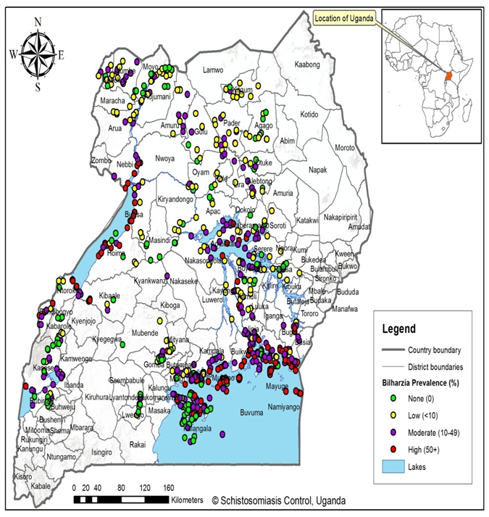
Prevalence/Geographical distribution in Uganda
The disease affects communities living along almost all water bodies
Uganda has both forms of Bilharzia
  Urinary 4/135 districts
  Intestinal type occur in 90/135.
90/134 districts are endemic for Bilharzia
Approximately 18 Million people are at risk of infection
An estimated 12million people are infected

Slide 64
Updates on targeted treatment for Schistosomiasis in Uganda

Slide 65
Sub-district level or Sub-IU level
refers to the lowest administrative level possible below the current implementation level/unit (IU), for which;
  shape files,
  epidemiological and
  demographic data are available for analysis.
Sub-district, sub-IU and sub-unit are used interchangeably in the document.
District (IU)>subcounty>Parish/ward>village/cell

Slide 66
District VS sub-district endemicity categories
# of Districts | # of sub-districts | Endemicity by district (JRSM) |  |  |  |  | Endemicity by sub-district
 |  | NE | LO | MO | HI | UN | NE | LO | MO | HI | UN
135 | 7501 | 44 | 39 | 14 | 37 | 0 | 469 | 664 | 470 | 140 | 0
NE: Non endemic LO: Low MO: Moderate HI: High UN: Unknown

Slide 67
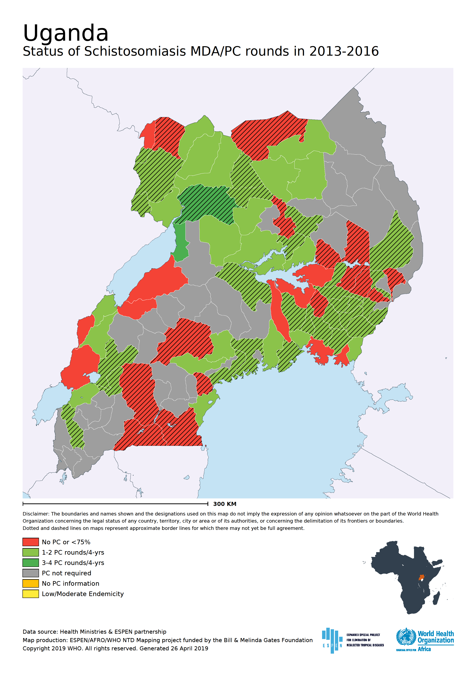
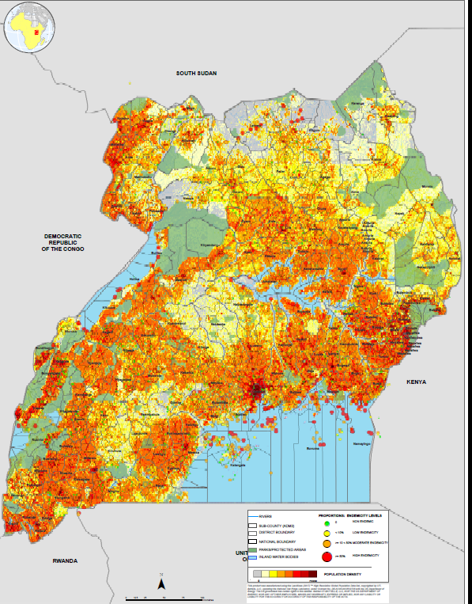

Slide 68
Change in endemicity categories
District classification | # of sub-districts | Sub-district classification
 |  | Non endemic | Low | Moderate | High | Unknown
Non endemic | 1,012 | 88 | 227 | 181 | 41 | 1,790
Low | 3,883 | 113 | 204 | 159 | 42 | 1,133
Moderate | 1,812 | 111 | 149 | 92 | 32 | 1,148
High | 95 | 157 | 84 | 38 | 25 | 1,687
Unknown | 699 | 88 | 227 | 181 | 41 | 1,790
Total | 7,501 | 469 | 664 | 470 | 140 | 5,758

Slide 69
Comments (if any)
Discussed and shared;
  WHO Uganda Office
  MoH NTD program Managers Meeting
  Supporting Partners
  District NTD Focal point persons

Slide 70
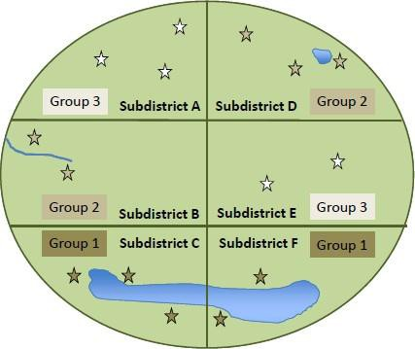
SCH Mapping protocol
Parishes classified based on the transmission risk categories/zones.
  1) Parishes within district where SCH is known to be present, zone
  2) Parishes within district where the SCH is suspected to be present,
  3) Parishes in district where SCH is suspected/not present/unknown.
The zones are used as proxy to distances where by
  zone 1 have all parishes that have or very close to water bodies where transmission is present
  zone 2) parishes with some water bodies(ponds, small rivers e.t.c where SCH is suspected or distant from the known transmission source.
  zone 3) parishes without water bodies/dry not suspected of SCH/far way from any known transmission source.
Parishes are small units-minimal likelihood of having many water bodies
All parishes within a district are grouped based on the zones (WHO recommend~atleast 5 schools (WHO-AFRO, 2014)
  5~7 schools are selected at random from each zone
  At District level (21 schools)are selected.

Slide 71
Results from Remapping/ Delineation

Slide 72
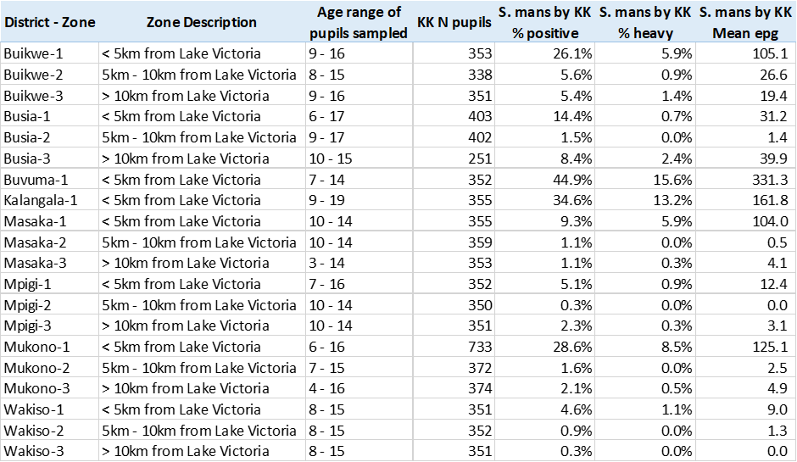
Results of Micro-mapping Strategy

Slide 73
Uganda MDA strategy/implementation
DISTRICT | District administrative units |  |  | SCH implementation units
 | #Sub county | #Parish | #Villages | #Sub county | # parishes | # Villages
Adjumani | 10 | 54 | 206 | 8 | 32 | 78
Agago | 16 | 78 | 934 | 16 | 78 | 934
Amolatar | 11 | 58 | 435 | 10 | 47 | 397
Apac | 11 | 65 | 735 | 8 | 49 | 548
Bugiri | 11 | 70 | 398 | 5 | 9 | 47

Slide 74
Challenges
  Scenario 1: Areas where transmission occurs on small water bodies, we have moderate to low prevalence and intensity
    These areas were supposedly targeted for elimination, but it was not implemented
        reaching non enrolled SAC during MDA
        Test and treat at frontline Health Centres
  Scenario 2: Areas near large water bodies with extremely high rate of schistosomiasis transmission:
    These areas were targeted for morbidity control
        High transmissions (Poor sanitation, low latrine coverage).
        Community fatigue with MDA ( Intensified HE &HP, supervision & monitoring).

Slide 75
Future plan
  Increase frequency of MDAs from once yearly to after every 6 months in high endemic foci-Bi annual MDA
  Ensure high treatment coverage through;
      Increased MDA supervision and mobilization to take drugs
      Increase number of drug distributors guided by kinship & by occupation
  Increase funding for Health education, sensitization and advocacy
      Advocate for increased funding for health education.
      Strengthen laboratories in frontline health facilities for diagnosis of schistosomiasis (Microscopy-KK& Urine Filtration).
  Ensure continuous schistosomiasis treatment in all health facilities in the high transmission foci.
  Ensure collaboration with WASH partners through advocacy.
  Build capacity and buy necessary drugs/equipment to manage severe disease
  Focal snail control where it is cost effective.

Slide 76
Conclusion
Mass treatment alone cannot adequately combat Schistosomiasis, hence supportive strategies are vital to achieve effective control.
Mass treatment excluding children below 5 years of age leaves a reservoir of infection and transmission.

Slide 77
Acknowledgement
World Health Organization
Government of Uganda (MOH, MoEST & MoLG)
Partners
Pharmaceutical Companies
Researchers
Communities
Schools

Slide 78
THANK YOU !

Slide 79
Agenda
Time | Activity/Topic | Facilitator / Speaker
5 Minutes 10 Minutes | Introduction Opening remarks and global update | Dr Maria Rebollo Dr Amadou Garba
20 Mins | Concept and progress update | Dr Pauline Mwinzi
15Mins | Q&A | ALL
40 Minutes | Overview of SCH-Sub district analysis workbook | Mr Boniface Kinvi
20 Minutes | Country experience | Uganda
5 minutes 5 mimutes | SCM issues Remarks on JAP timelines | Modeste Tezembong Honorat Zoure
20 Minutes | Q&A | ALL
5 Minutes | Closing remarks | ESPEN

Slide 80

Schistosomiasis sub-district level data review and analysis for shrinking the map; targeted treatment, better utilization of available prevalence
data and sub-district level planning
NTD Supply Chain Management
Mr. Modeste TEZEMBONG, Brazzaville, Congo, July 14,2020

Slide 81
Contents
What are the Steps of the NTDs Medicine Supply Chain?
What are the Challenges? And Suggestions?
Unaccounted medicines
Most common mistakes and inconsistencies in submitted JAP forms

Slide 82
What are the Key Steps of the Supply Chain Process specific to NTDs donated medicines? (1/2)
Medicine Quantification & Forecasting
Medicine Application submission
Medicine Application Review/Revision/Approval
Medicine Supply (external part)
  PO raising: PO request & PO raising
  PO received/acknowledged by the donors
  Shipping greenlight (tax exemption doc, import permit etc)
  Booking flight/vessel
  Customs clearance:
  Transportation to national warehouse

Slide 83
What are the Key Steps of the Supply Chain Process? (2/2)
In-country Medicine Management
  In-country Supply (Nat’l Warehouse to Tx points)
  Medicine Distribution (MDA/mass treatment)
  Medicine Distribution Report
    treatment & impact
    remaining balance
  Remaining Balance Reverse Logistics
The movement of the medicine is the backbone of NTD PCT Programme!

Slide 84
Inaccurate Quantification
Overestimation
Underestimation
Lack of supply planning and coordination
Late Submission
Poor quality
Major NTDs Supply Chain Challenges
Late Review/Approval/clearance
JAP submission
Review & Clearance
Purchase Ordering
Pharma production
Green light
Shipping
Customs clearance
MDA
Country
Warehouse
In-country distribution
Quantification and Forecasting
Poor Inventory at country level
Poor treatment data reporting
ineffective reverse logistics
Late PO raising
Supply Chain Cycle
&
Challenges
Lack of transport, funds etc
Limitation in production (capacity, timing etc)
Timing of MDA???
MDA date at the same quarter/period
Short Shel-fife (PZQ & MEB)
Shortage of Warehouse or poor quality etc.
Late green light
tax exemption
import permit
Special labelling
Pre-shipment inspection
Delayed clearance
Booking time

Slide 85
Unaccounted Medicines or Unjustified Medicines
A= Supplying qty or the donated Qty
B = Distributed/Tx qty + Expired/Lost qty +
Remaining balance
Unaccounted Medicines = A – B
If the result is < or = 0, then then country stock status is correct
If the result is > 0, then there should still medicines in the country that were properly not reported

Slide 86
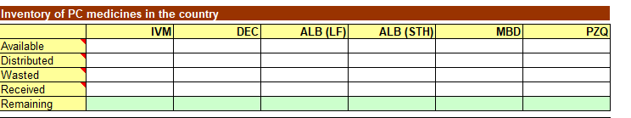
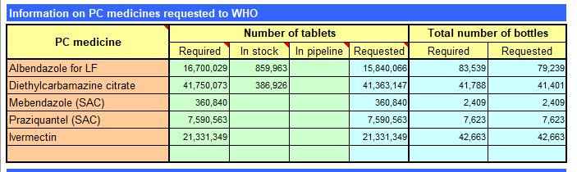
Physical Inventory count & the Remaining Balance
JRF SUMMARY SHEET
JRSM SUMMARY SHEET

Slide 87
Example of an Unaccounted situation
Example from the Republic of Murconia on PZQ donation for SCH

Slide 88
Deadline for submitting JAP
to ESPEN: 15 July 2020
JAP forms submitted
for 2021 MDA
JRSM with sub-IU analysis
Togo
Rwanda
Burkina Faso
Ghana
Mali
Burundi
Malawi

Slide 89
Most common mistakes and inconsistencies in submitted JAP forms
Medicine request form and Treatment report
  Population figures changing in an inappropriate manner
  Endemicity status changing without supporting new prevalence data
  Treatment frequency dependent on prevalence level (for SCH)
  Target population of SAC greater than total SAC
  Oncho or Schisto being focal within the district, but not reported as such for certain years
  Medicine for treatment of STH not selected, hence number of tablets for STH not computed
Epidemiological reporting form
  Geographic coordinates of survey sites not reported, or reported in a wrong format
  Type of survey not specified (Mapping, sentinel site, TAS,…)
  Year of survey not reported

Slide 90
What is a good quality application?
Justifiable
    Endemicity level for each district in line with the latest mapping or impact assessment results
    Number of MDA round matches with the endemicity level
    Targeting appropriate age-group
    Demography based on the most recent available census data
    Population requiring PC adjusted to the transmission zone
    Select medicine for treatment (for STH)
    PC strategy in line with WHO recommendations
    EPIRF: Latest mapping/sentinel sites/impact assessment results attached
    AW: Existing Plan of activities with funding and partners
Complete
    In country inventory (tablets in stock)
    Shipping Contact information (consignee contact person’s address, email, phone number, etc)
    Date by which the medicine should arrive to the national warehouse
    Dates planned for the MDAs

Slide 91
Agenda
Time | Activity/Topic | Facilitator / Speaker
5 Minutes 10 Minutes | Introduction Opening remarks and global update | Dr Maria Rebollo Dr Amadou Garba
20 Mins | Concept note and progress update | Dr Pauline Mwinzi
15Mins | Question and Answer | ALL
40 Minutes | Overview of SCH-Sub district analysis workbook | Mr Boniface Kinvi
20 Minutes | Country experience | Uganda
5 minutes 5 mimutes | Remarks on JAP timelines SCM issues | Honorat Zoure Modeste Tezembong
20 Minutes | Q&A | ALL
5 Minutes | Closing remarks | ESPEN

