Slide 1
Using ESPEN Collect survey support services to conduct PC-NTD surveys
February 10, 2021

Slide 2
ESPEN Collect - A full package of support of epidemiological and coverage surveys
ESPEN provides support to NTD Programme Managers through protocol review by WHO disease subject matter experts to ensure surveys are conducted in accordance with WHO guidelines
ESPEN Collect is a mobile-based data collection tool (Launched in August 2018). As with other tools, ESPEN Collect works online and offline and supports multiple languages. Surveys are standardized and come with standardized training materials
ESPEN augments their capacity by enabling national NTD Programme teams to perform an active role in the data management process. ESPEN Collect provides a real-time quality control dashboard that highlights data issues that require conversations with field teams
ESPEN Collect is a data platform that is integrated with the ESPEN NTD Portal
ESPEN Collect can automatically produce the Epidemiological Reporting Form (EPIRF) from completed survey results
ESPEN Collect can give Programme Managers the tools they need to reduce the NTD data fragmentation resulting from multiple data collection systems being used to collect epidemiological survey data

Slide 3
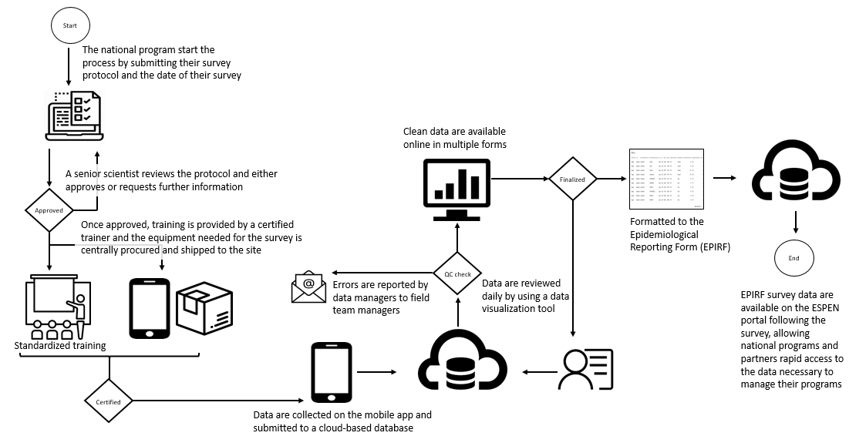
ESPEN Collect - Data flow overview
ESPEN Collect online registration and tracking system
Results are automatically formatted into the EPIRF
Protocol review and support from WHO/ESPEN scientists
Real-time quality control dashboard available to the national NTD programme
Standardized training materials for all supported survey types
Results are available to the global community on the ESPEN NTD Portal.
2/10/2021

Slide 4
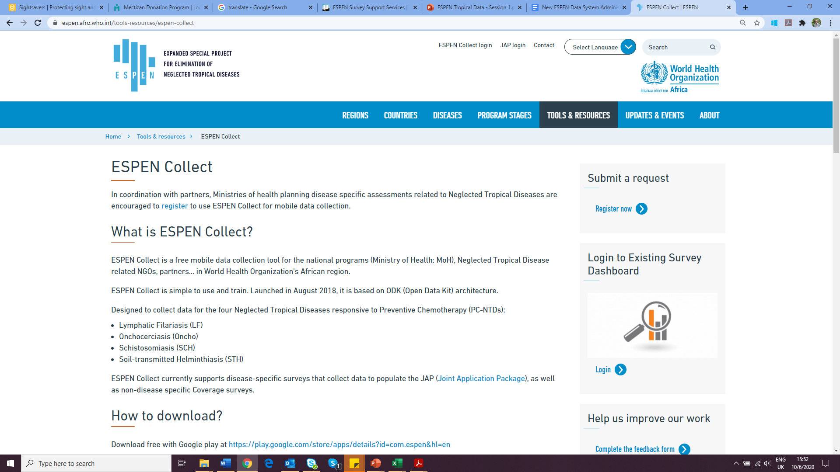
How do you sign up for service?
In coordination with partners, MoH, send a request to use ESPEN Collect by completing the registration form on ESPEN Portal
Fill out the registration form for each survey type being requested
Survey protocol must be submitted at least 6 weeks before intended start date
Registration process for new users invited by ESPEN Team before submitting new request
http://espen.afro.who.int/espen-collect-survey-registration
2/10/2021
Notes:
EPIRF

Slide 5







Survey support milestone
Survey support milestone
Form designing & dashboard setup
Training of surveyor's team
Protocol review
From standard forms & dashboard templates
By ESPEN SME
1 week before data collection
1-2 weeks
04
02
06
Data collection starts
Complete registration form
Share User guide and Training material
6 weeks before data collection
Initial call
Form completed online, ESPEN Portal
Discussion about survey preparation
Call with M&E and country data management team
01
03
05
1st week
2nd week
3rd week
5th week
6th week
2/10/2021
Using ESPEN Collect to conduct PC-NTD Surveys

Slide 6
Training
Working with partners and WHO country offices to create a network of regional trainers
Technical trainers
  Use of diagnostics
    ESPEN has a pool of regional technical consultants
    Implementing partners
Data trainers
  Use of phones
  Use of data/Metabase
    ESPEN has a pool of data demand consultants
    Implementing partners
2/10/2021
Using ESPEN Collect to conduct PC-NTD Surveys

Slide 7
Supervision
For supervision we use:
  Metabase: Online data visualization & Quality check
  Weekly call with field teams
  If necessary, WhatsApp group are created where supervision team sends daily summary of the activity
2/10/2021
Using ESPEN Collect to conduct PC-NTD Surveys

Slide 8
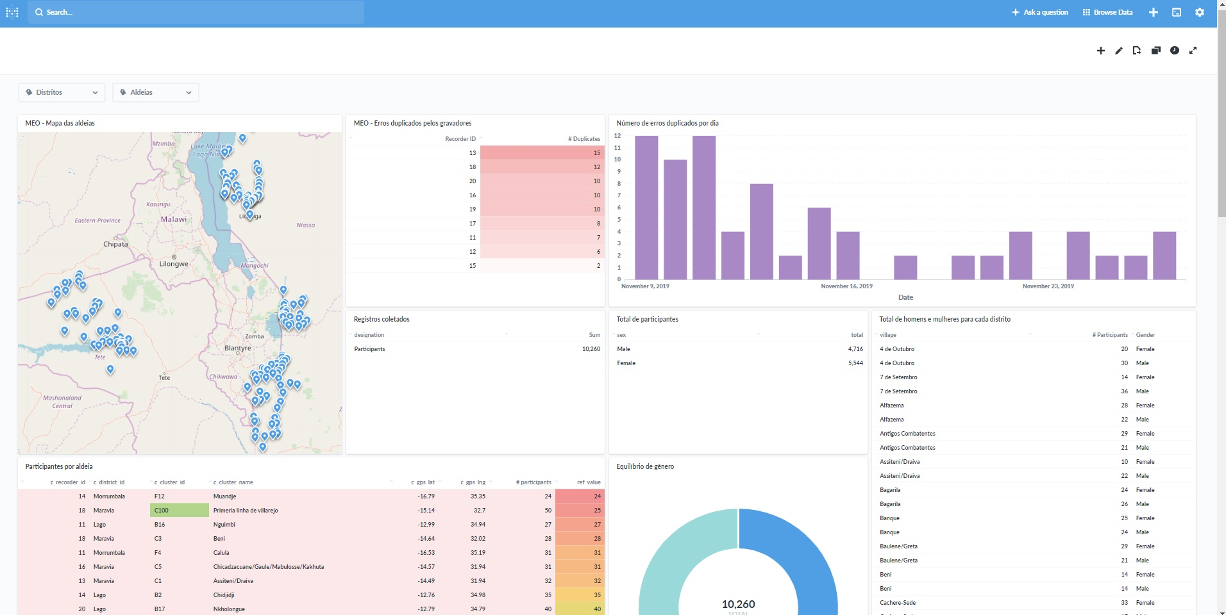
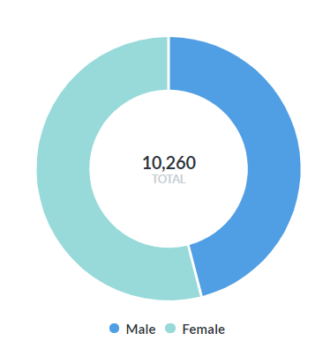
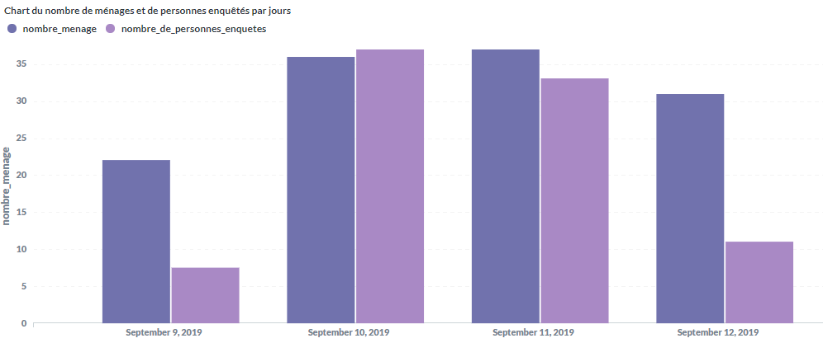
Quality control dashboard
The ESPEN Collect dashboard is designed to provide data managers, both at ESPEN and at the MOH, results in a format to quickly identify data issues and follow up with field teams
New data sent from the field will automatically update the dashboard
Dashboard layouts are standardized by survey type so that users don’t need to learn a new layout each time they use ESPEN Collect
2/10/2021

Slide 9




Data monitoring
01
02
03
04
Prepare tools
Send details about errors
Prepare the Metabase dashboard and send and invitations to people the country wants to grant access. The dashboard will contain reports about the survey, the raw data, and data formatted to EPERF.
Apply correction
Create EPIRF Mirror
Send details about the errors and recommendations to the supervisor and the team. Send also suggestions on how to clean data and how to avoid this mistake in the future.
Receive corrected data from the supervisor and apply them on Metabase
Create the EPIRF mirror on Metabase and send the email to the supervisor for asking him to check on the cleaned data and the EPIRF mirror.
2/10/2021
Using ESPEN Collect to conduct PC-NTD Surveys

Slide 10
Help desk
For each supported survey we share a guide with screenshots of ESPEN Collect app
Download new forms
Update existing forms in smartphones
Send finalized forms, etc
Training materials are shared with both Countries and Trainers : contain clear steps on trouble shooting
Weekly monitoring calls are set with field teams to address issues and monitor the evolution of surveys
WhatsApp group are created to allow quick errors flagging and address
2/10/2021
Using ESPEN Collect to conduct PC-NTD Surveys

Slide 11
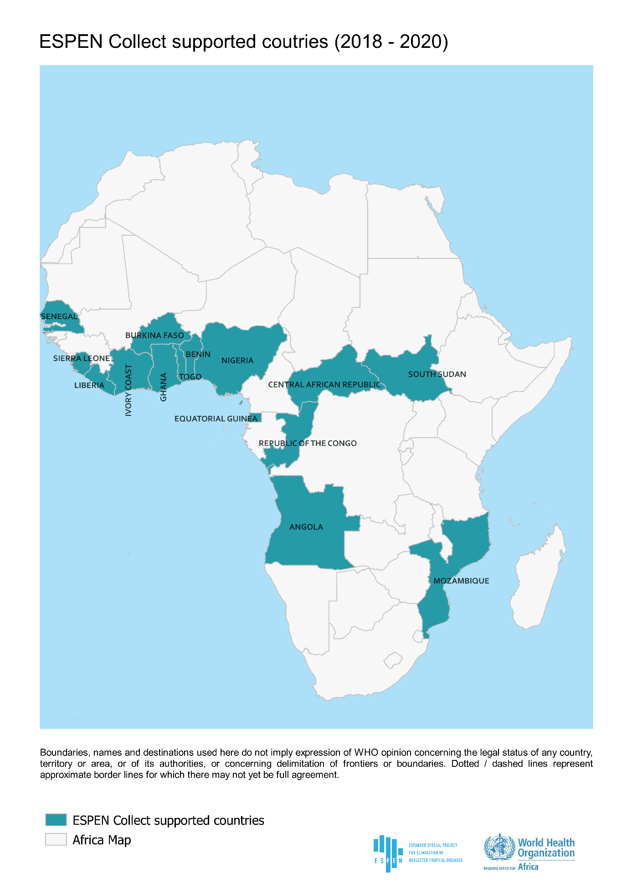
Supported surveys 2018-2020
Country | LF Surveys | SCH surveys | STH surveys | ONCHO surveys
Angola |  | 1 | 1
Benin | 2 |  |  | 1
Burkina Faso | 6 | 1 |  | 3
CAR | 1 | 1 | 1
Congo |  |  |  | 2
Equatorial Guinea |  |  |  | 1
Ghana |  |  |  | 1
Ivory Coast | 1
Liberia |  |  |  | 2
Mozambique | 1 |  |  | 2
Nigeria |  |  |  | 2
Senegal | 1
Sierra Leone |  |  |  | 1
South Sudan | 2 | 2 | 2
Togo |  |  |  | 1
Total | 14 | 5 | 4 | 16
15
countries
33
Surveys
3,361+
sites visited
2/10/2021
Using ESPEN Collect to conduct PC-NTD Surveys

Slide 12
Challenges & Opportunities
Challenge: Poor reporting rates and quality for the EPIRF
Opportunity: Mirror the accomplishments of the GTMP/TD to achieve quality and standardization for trachoma surveys for the other PC NTDs
  Hoping to improve coordination with Tropical Data to provide a more unified user experience for Programme Managers
  ESPEN Collect supports all survey types reported in the EPIRF as well as treatment coverage surveys
    Implementing the EPIRF generator (demo)
  Getting a list of surveys planned for 2021 from implementing partners now so you can plan resource allocation
  Coordinating with partners and countries to fill reporting gaps
2/10/2021
Using ESPEN Collect to conduct PC-NTD Surveys

Slide 13
Thank you!
2/10/2021

