Slide 1
ESPEN Collect
Training for Instructors

Slide 2
What is ESPEN Collect?
A free data collection application, used for surveys of neglected tropical diseases
Mobile tool:
Uses the Secure Data Kit platform
It allows offline data collection, enabling users to upload data later
Data visual

Slide 3
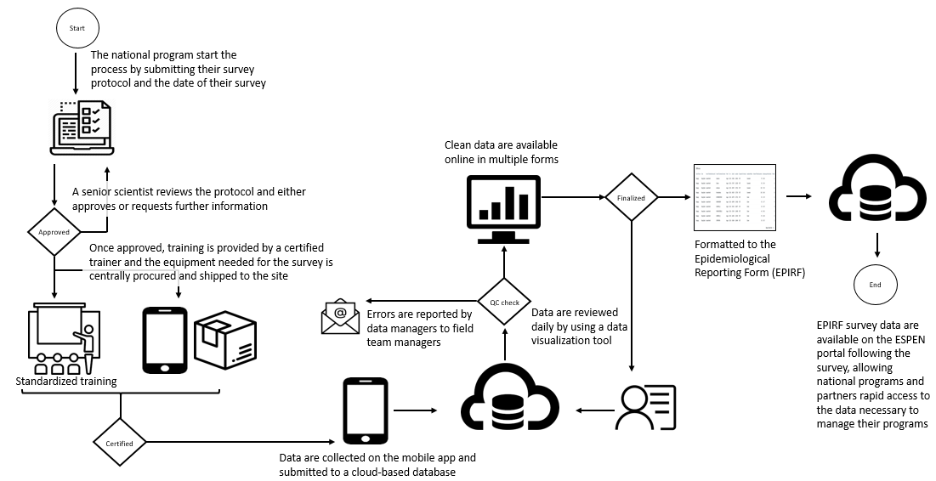
ESPEN Collect is more than just an app
1
There are five main components of the ESPEN Collect survey support services:
Registration
Training
Data collection
Online dashboard for quality control
Generation of the EPIRF
4
5
1
2
2
3
4
3
5

Slide 4
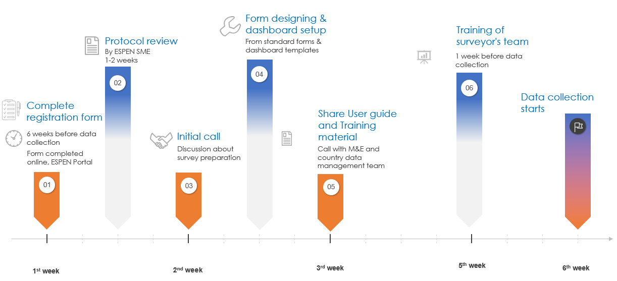
Timeline – 6 weeks lead time is needed

Slide 5
Let’s start with week 1, registration

Slide 6
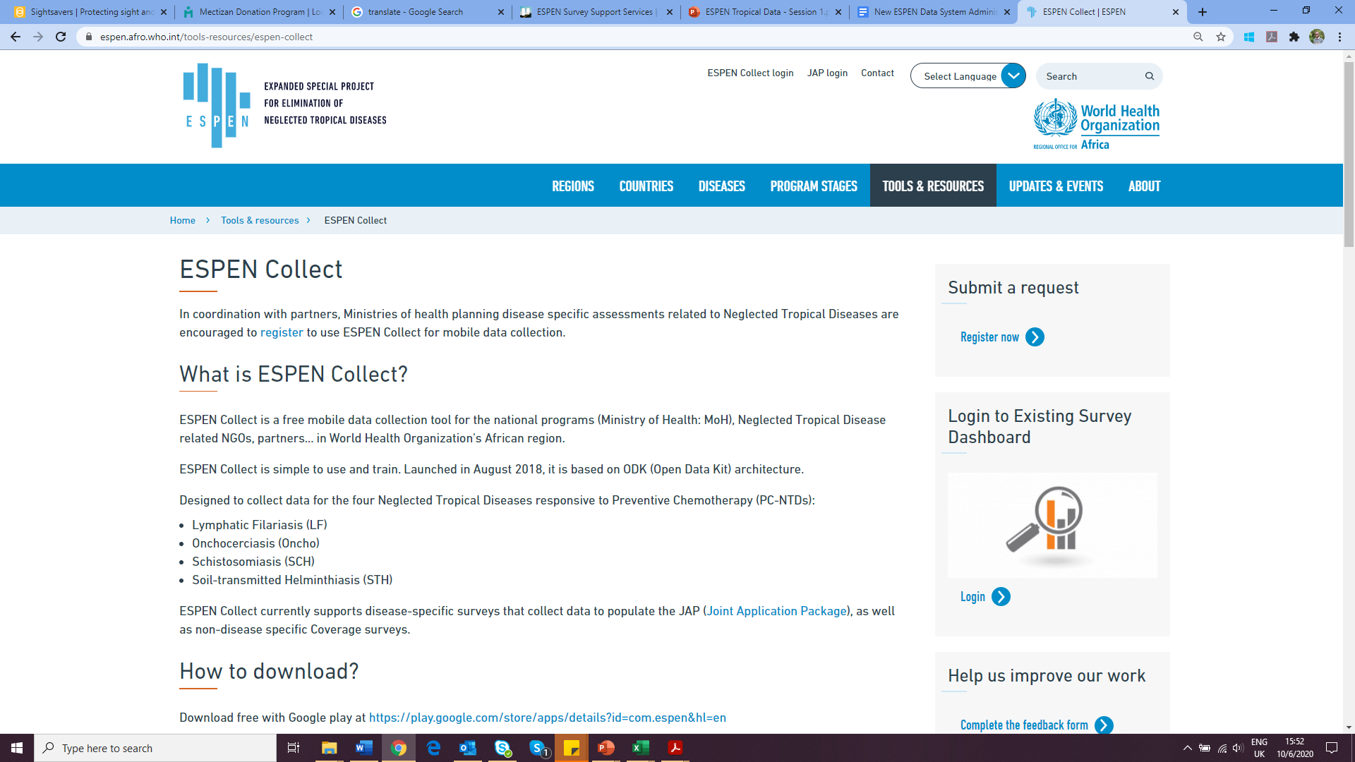
Registration (1 of 2)
Registration is a required first step to use ESPEN Collect. To get started, go to the ESPEN Portal and click on Tools & Resources and click on ESPEN Collect. During registration you will fill in a survey noting:
Survey type
Survey protocol
List of individuals who should have access to the project datashboard

Slide 7
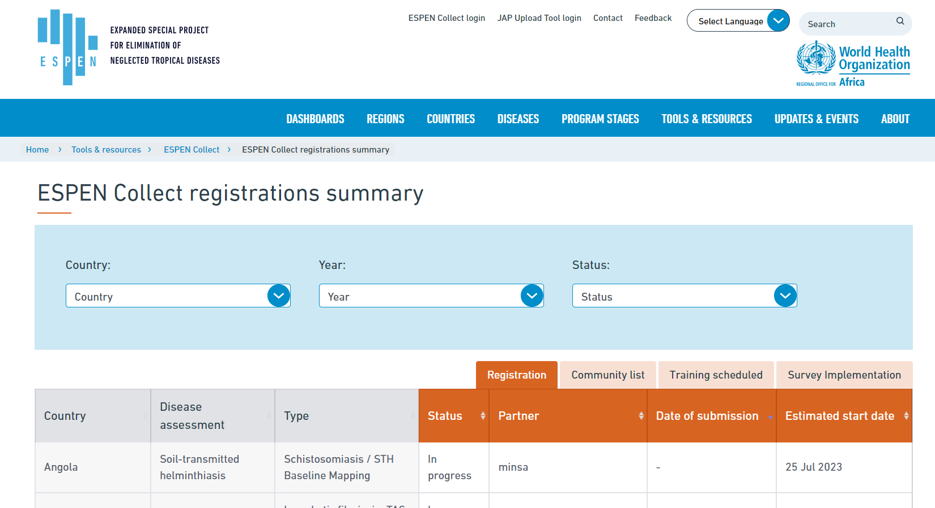
Registration (2 of 2)
https://espen.afro.who.int/tools-resources/espen-collect/registration-summary
Once registration has been started, you can track the progress of your survey on the ESPEN Portal. This survey tracking tool is open access so anyone can review the progress, even if they were not granted access to the project dashboard.
Click on the tabs to view various stages of the survey from registration, to setup, to training, to implementation

Slide 8
After registration is complete, move on to protocol review and setup

Slide 9
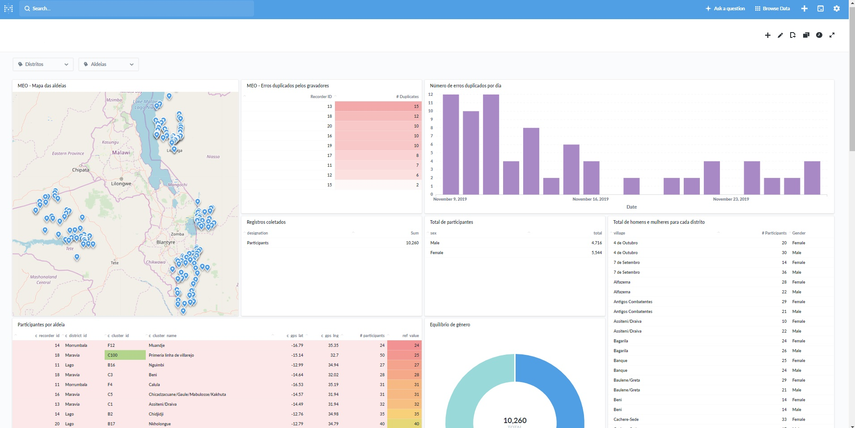
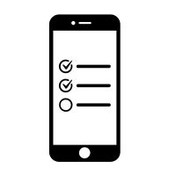
Setup
Review the survey questions, which will likely include a community list unique to your project as well as a dashboard to quickly identify progress and any potential data collection issues during the survey. Data, ideally, are sent daily and will be immediately available in the dashboard.
Dashboard setup
Mobile app setup
Community list
Standard survey
Finalized survey

Slide 10
After setup, conduct training

Slide 11
Training
There are three unique training groups: Group 1 (The trainers): Group 1 requires training on setting up phones with the ESPEN Collect app and configuring the necessary settings to download the survey. Once trained, this group will then be responsible for training Group 2.
Group 2 (The data collectors): This group needs to be trained on how to use the phones once they have been setup. Here the focus is on understanding the user interfact of the mobile application and understanding the survey questions. This group will also likely be trained on other elements of the survey protocol such as sampling method, collection of samples, and other protocol specific implementation information.
Group 3 (The supervisors): This group will not collect the data using the ESPEN Collect app, but rather review the data sent from the app using the ESPEN Collect dashboard.

Slide 12
Training: Group 1
Group 1: This group needs to be trained on how to setup the phones with the ESPEN Collect app and configure the settings to download the survey.
Task: Work with the group to practice
Installing the ESPEN Collect app and downloading forms.
Testing each question in the form to understand its structure.
Material:
Step-by-step Guide: Link
ESPEN Collect training for data Collector: Link
ESPEN Collect Quick Trouble Shouting Guide: Link
ESPEN Collect App: Link

Slide 13
Training: Group 2
Group 2: This group needs to be trained on how to use the phones once they have been setup. Here the focus is on understanding the user interface of the mobile application and understanding the survey questions. This group will also likely be trained on other elements of the survey protocol such as sampling method, collection of samples, and other protocol specific implementation information.
Material:
ESPEN Collect training for data Collector: Link
ESPEN Collect Quick Trouble Shouting Guide: Link
ESPEN Collect App: Link

Slide 14
Training: Group 3
Group 2: This group will not collect the data using the ESPEN Collect app, but rather review the data sent from the app using the ESPEN Collect dashboard.
Material:
ESPEN Collect training for data Collector: Link
Metabase Guide: Link

Slide 15
Role of ESPEN Collect support
The ESPEN Collect team is here to support you throughout the process by providing the following services:
Integrating the community list with the disease survey
Setup of the project dashboard and adding all authorized users as requested in the survey registration
Reviewing data as it is submitted and communication with the supervisor regarding an issues during data collection
Any data cleaning or other data management during or immediately following the survey
Generating the Epidemiological Reporting Form (EPIRF) and sending this form to the MOH for their review and submission as part of annual reporting form Joint Application Package.

Slide 16
Thank you and best of luck with your survey!

